Slide 1
Student Success Collaborative
Navigate
Quick Start Guide for Navigate
GETTING STARTED
1. Log in to Navigate using your SSO credentials!
ndm.campus-training3.eab.com - available for training/practice
ndm.campus.eab.com - start using on DATE
2. Configure Availability and Calendar for Appointment Scheduling
Set Up Your Availability - This is an important first step that will allow you to then create appointments with students by selecting the ‘Add Time’ from your Staff home screen - see Appendix A for detailed instructions on setting up your Availability.
Sync Your Calendar - This initiates the two way sync between Navigate and your calendar. See Appendix B for detailed instructions.
KEY PLATFORM FEATURES
Perform These Key Actions to Identify, Communicate With, and Support Students – update for features that will be available at go-live!
Reference the Student Profile – After clicking on a student’s name through the search results, your Staff Home, or the Quick Search, note their Academic progress and any areas of concern with the various tabs on a student’s profile
Add Notes or Advising Summary Reports – Record your interactions and follow-ups from student meetings by adding an Appointment Summary Report (record associated with an appointment) or a Note (general record not associated with a specific meeting)
  Both are accomplished through the ‘Actions’ menu on your Staff home or search results, or from a student’s profile.
Mass Email and Text a Group of Students – Use ‘Send a Message’ from the ‘Actions’ drop-down to contact your advisees or other lists you’ve created in the platform.
Create an Appointment Campaign - Use this to invite students set up an appointment during times you have designated –
  From the ‘Actions’ menu on your list, select ‘Appointment Campaign’ – See Appendix E for detailed instructions on creating a campaign.

Slide 2
Expectations: What should you be using Navigate for?
CUSTOMIZE BY USER GROUP (See Example Below)
Workflow | Advisor Department Advisors, Faculty Graduate Advisors | Student Success Users | Faculty
Review student profile before appointment | Student Overview, Categories, Success Progress, History, Class Info, and Path tabs | Student Overview, Categories, Success Progress, History, Class Info, and Path tabs | Student Overview, History, Class Info, and Path tabs
Capture details about advising interactions | Add advising summary report after each appointment (Advising Care Unit) Drop-ins: Student Profile -> Report on Appointment Campaigns: Upcoming Appointments tab | Phase II | Phase II
Contact students through navigate | Email and text students (see communication policy examples) Create Searches and Student Lists to contact students from Advanced Search | Email and text students (see communication policy examples) Create Searches and Student Lists to contact students from Advanced Search | Email and text students enrolled in your courses (see communication policy examples)
Schedule appointments | Set up availability for Appointments and Drop-Ins (Advising Care Unit) Appointment Campaign guidelines (Phase II) | Phase II | Phase II
Issue alerts | Phase II | Issue an Alert on students for referrals Manage assigned cases | Issue an Alert on students for referrals Progress Reports

Slide 3
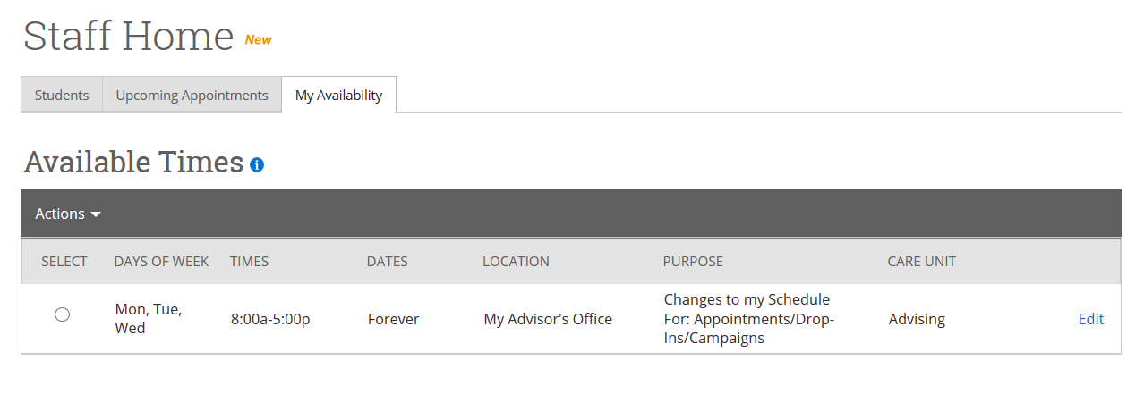
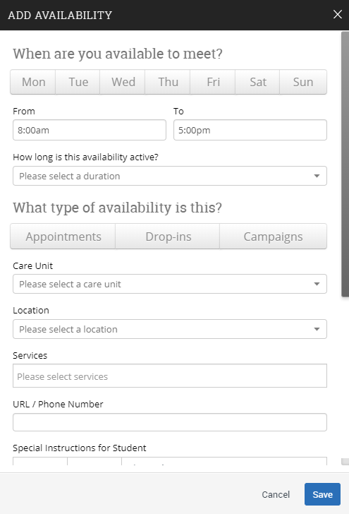
Appendix A: Setting Up Your Availability
Availability
As a new user, the first thing you need to do is set up availability so that students can schedule appointments to see you. It is important to note that locations and services are created by university administrators.
Add Time -
Step 1: Click the Add Time button in the Actions Menu
Step 2: Select the days and times when you are available to meet with students.
Step 3: Select whether you will meet with students via appointments or drop-ins during that time. The campaign option is availability reserved specifically as dedicated time for targeted students to make appointments with you.
Step 4: Choose the location where you will be available.
Step 5: Select which student services you can provide to students during this availability. Note: Leaving this student services field empty means you will appear to be available for all advising student services.
Steps 6-8 Continued on next page…

Slide 4
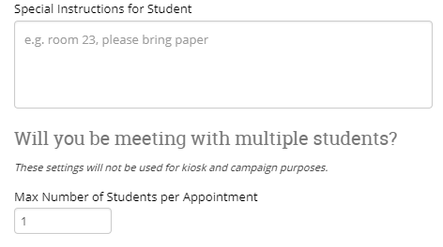
Appendix A: Setting Up Your Availability
Step 6: Use the Special Instructions box under “Add Availability” to include personalized information, such as your office room number and location.
Step 7: Click the Save button.
Step 8: Repeat this process until all of your availabilities have been defined.
You can have as much availability as needed.
Creating multiple availabilities will enable you to set aside specific blocks for specific services (registration advising for example) or meeting types (drop ins vs. scheduled appointments)
Editing Availability:
Copy Time - to copy a time, select the time you would like to copy and then click the Copy Time button. The availabilities will be copied and a dialog will open allowing you to make edits or to save your newly created availability.
Delete Time- to delete your time, simply select the time and click the Delete Time button.
Group Appointments - You are now able to create availability for group appointments by indicating how many students are able to schedule into the same appointment.
Inactive availabilities are highlighted in red in the Times Available grid.

Slide 5
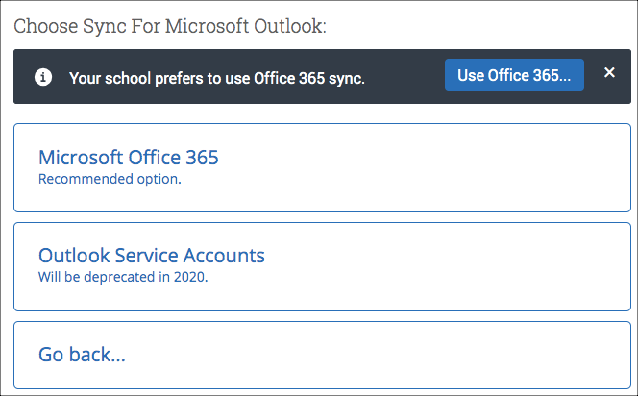
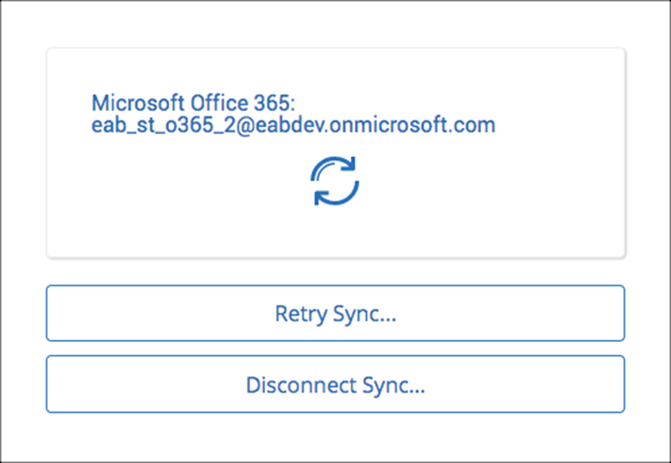
Appendix B: Sync Your Outlook Calendar
Integrating Your Calendar
The availability you set up within Navigate dictates students’ ability to schedule appointments with you. You have the added option to integrate your calendar with the Navigate platform to pull in Free/Busy times from your personal calendar and push appointments scheduled in Navigate to your personal calendar.
Toggle to the calendar page within Navigate using the calendar icon on the left side toolbar.
Select Settings and Sync on the top right side of the page
Click Setup Sync. You will see a “Your school prefers to use Office 365 sync” banner on Calendar with a “Use Office 365…” button to begin the setup.
Upon clicking the button, you will be routed to login.microsoftonline.com. If the you are not already signed into Office 365, you will be prompted to sign in.
After signing in, Office 365 will ask you to grant permission for the application to access your calendar. Pressing “Accept” will authorize and begin the syncing.
The browser will return to the Calendar Integrations page. The “Exchange Integration” tab will no longer appear. The “Office365 Integration” tab will now show the timestamp for the last successful sync (or any applicable error message) and will include options for you to Retry or Disconnect the sync as needed.
The Two-Way Sync will enable that any agenda item created from Navigate will sync back to your Outlook Calendar. All existing events and events that are created from your Outlook Calendar will be shown as ‘Busy’ in Navigate

Slide 6
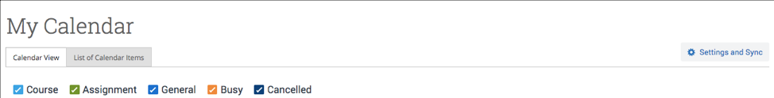
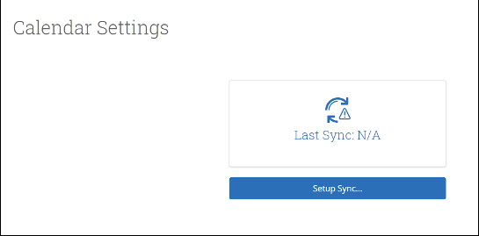
Appendix B: Sync Your Outlook Calendar
Integrating Your Calendar
The availability you set up within Navigate dictates students’ ability to schedule appointments with you. You have the added option to integrate your calendar with the Navigate platform to pull in Free/Busy times from your personal calendar and push appointments scheduled in Navigate to your personal calendar.
Select the calendar icon in the left navigation bar. Once on the My Calendar page, select the Settings and Sync button.
On the Calendar Settings page, select Setup Sync…

Slide 7
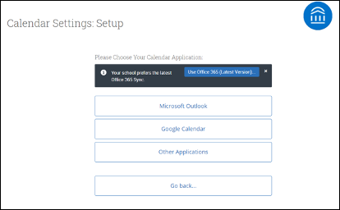
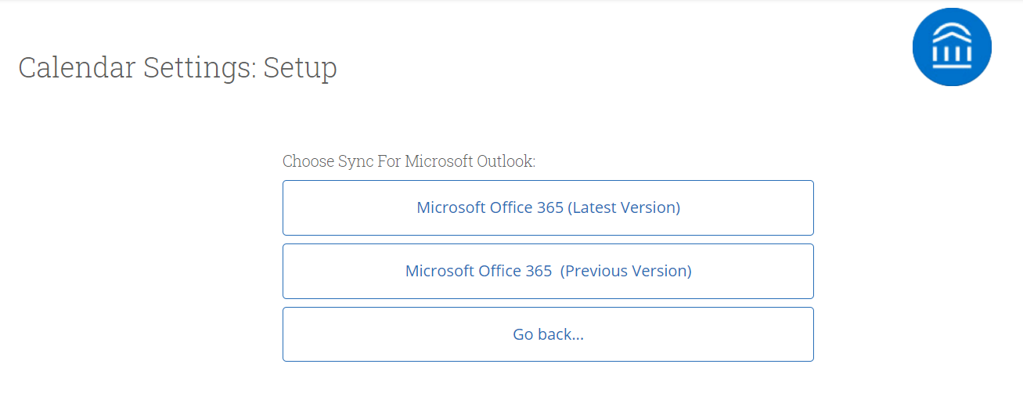
Appendix B: Sync Your Outlook Calendar
Integrating Your Calendar
If you see the following screen, click the button that says Use Office365 (Latest Version) at the top of the list of options, as in figure 3.
If you click Microsoft Outlook instead of the Use Office365 (Latest Version) button, you choose your Microsoft Outlook sync. Select Microsoft Office 365 (Latest Version) from the options.
Regardless of which method you choose, the Microsoft login and authorization page opens. The page tells you to pick an account. Choose your professional account.

Slide 8
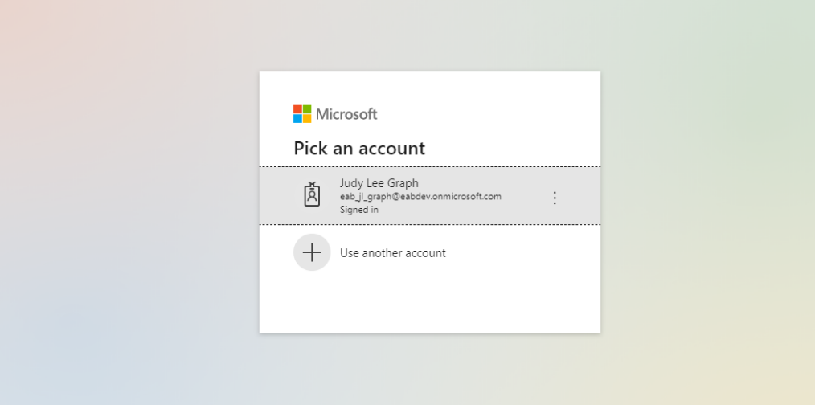
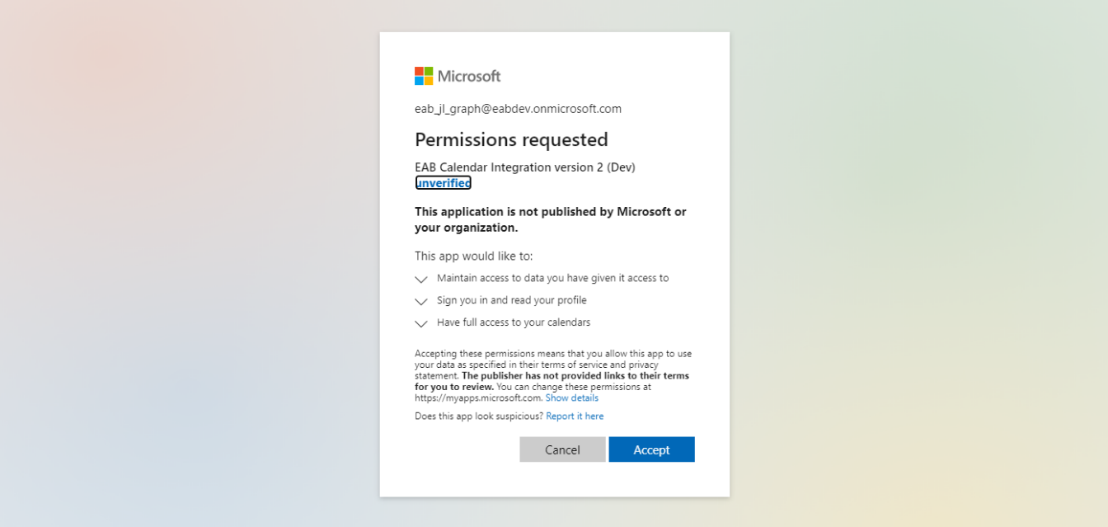
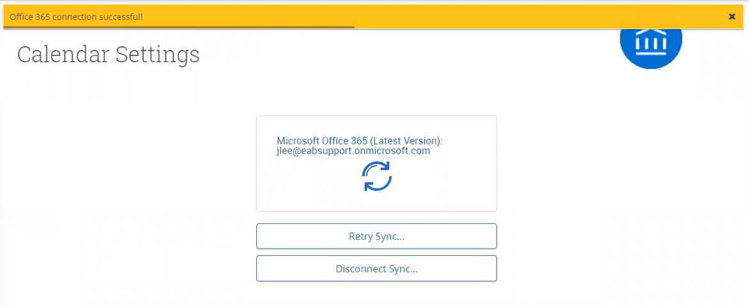
Appendix B: Sync Your Outlook Calendar
Integrating Your Calendar
If you log in successfully, you see a page requesting permissions.
Select Accept. The page redirects to the Navigate Calendar Settings page, with a success message and information about the sync on display.

Slide 9
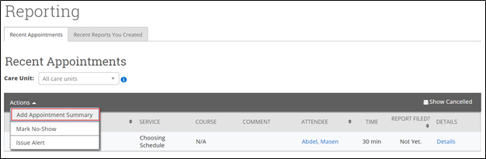
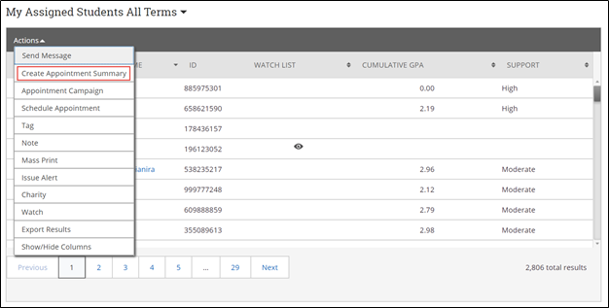
Appendix C: Add Advising Summary Reports
Documenting a Student Interaction
Summary Reports can be created during or after meeting with students. You can add a summary report to an appointment scheduled in advance, create a summary report for a walk-in appointment, mark a student as a no show, or edit existing summary reports.
For Scheduled Appointments: There are several different ways to create an Appointment Summary Report for scheduled appointments. Add Appointment Summary is an option in the Actions drop-down menu throughout the platform. The easiest way to access your appointments is from your Staff Home page. Under the Students tab on Staff Home, scroll down and find your Recent Appointments. From this section, you can click on a student and select Add Appointment Summary from the Actions drop-down menu. You can also access this section from the Upcoming Appointments tab of Staff Home.
Note: It is important to always create Appointment Summary Reports from the scheduled appointment itself, rather than ad-hoc, to ensure the Summary Report is tied to that specific appointment.
For Drop-in Appointments: There are several different ways to create an ad-hoc Appointment Summary Report for walk-in appointments. Create Appointment Summary is an option in the Actions drop-down menu throughout the platform. The easiest way to create an ad-hoc Appointment Summary Report for a walk-in appointment is from Staff Home or a student profile. Under the Students tab of Staff Home, find the specific student in your My Assigned Students section, or click the drop-down to find the student from one of your saved lists. From this section, you can click on a student and select Create Appointment Summary from the Actions drop down. This will create an Appointment Summary and add that appointment to your calendar in the past.

Slide 10
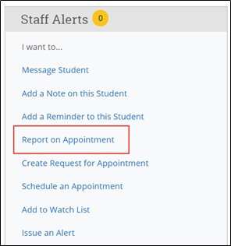
Appendix C: Add Advising Summary Reports
Documenting a Student Interaction
You can also create an ad hoc Appointment Summary Report from a student’s profile page. Navigate to that specific student’s profile and click Report on Appointment from the Actions menu on the right. This will create an Appointment Summary and add that appointment to your calendar in the past.
Reminder: When creating an ad-hoc Appointment Summary Report to track walk-in appointments, the Navigate platform will create the relevant appointment on your calendar for the date and time you selected in the past. Creating that appointment helps our system keep track of all appointments happening with students, regardless of whether they were scheduled or walk-ins. If you sync your professional calendar to the Navigate platform, this appointment created in the past will also sync to that calendar.
For No-Show Appointments: The primary way to mark a student as a no-show for a scheduled appointment is from Staff Home. On the Students tab, scroll down and find your Recent Appointments. From this section, you can click on a student and select Mark No-Show from the Actions drop down. You can also access this section from the Upcoming Appointments tab of your homepage. Marking a student as a no-show still adds a Summary Report to the appointment. The only difference is that the box next to the student’s name called Attended will not be checked. See the screenshot below.
Important Note: Any information you enter into Navigate pertaining to a student becomes a part of their official student record and may be subpoenaed by that student, as outlined in the Family Educational Rights and Privacy Act (FERPA).

Slide 11
Appendix D: Mass Email and Text a Group of Students
Communicating with Students
Navigate provides both email and text messaging for faculty and staff to communicate with students, either individually or en masse. Communicating with students through the platform creates records of those communication which can be accessible by other staff or faculty on your campus. In addition, it allows for a quick and easy way to communicate with more than one student at once.
Any faculty or staff member will only be able to view communications in which they have the proper permissions. Permissions allow users to either view only their own communications with students, or to view all communications with students. If you are unsure who can view your communications, contact your Application Administrator.
How do I send the emails or texts?
You can send emails or texts to one or more students from your staff homepage, the student profile, or the advanced search. Most “Actions” menus throughout the platform allow for sending emails or texts. See below for screenshots of each of these locations.
Send a message from the Staff home page (fig. 1)
Send a message from the Student home page (fig. 2)
Send a message from the Advanced Search (fig. 3)
Important Note: If you do not see the option to Email or Text students, then your role does not have the proper permission for this action, or your institution decided not to allow texting. Please contact your Application Administrator with questions.

Slide 12
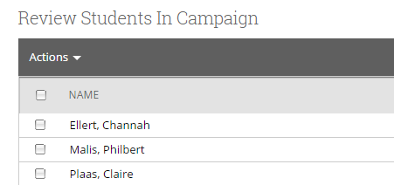
Appendix E: Creating an Appointment Campaign
Navigating to Campaigns: While on the staff home screen, select “Appointment Campaigns” from the left hand side Quick Links section. This will take you to the Campaigns tab. From there, select Appointment Campaign from the right hand side, under Actions.
Define Campaign:
  Name your campaign (Students will not see the name of the campaign)
  Select “Advising” as the Care Unit (or the applicable Care Unit for your campaign)
  Location- Choose your location. NOTE: Ensure that for the campaign availability you have created under “My Availability” you have selected that you will be available in the same location (Advisor’s office).
  Under “Service”, choose the services for which you are available. NOTE: This must match the availability you have set up on your staff home page, under “My Availability”.
  Begin Date and End Date- choose the date range for which you want the campaign to run. If a student tries to schedule outside of that time period, they will receive a message stating that the campaign has expired. NOTE: This must match the availability you have set up on your staff home page, under “My Availability”.
  Appointment Limit- how many appointments can the student schedule for the campaign? (default is 1)
  Appointment Length- how long do you want the appointment to last?
  Select 1 slot per time (select more if you’d like more than 1 student to select the same time slot)
Adding Students: Use the advanced search feature to search for students you would like to participate in the campaign. Or, choose one of your saved searches by clicking the drop down arrow beside “Saved Searches”.
Adding Staff: If you have correctly set up your availability for Campaigns then you should see your name on the next page under “Add Advisors to Campaign”. If applicable, select other advisors to join your campaign.
Compose Your Message:
  Create a Subject Line for your email
  In the next box, edit the text for the email. Default is “Please schedule your advising appointment”. NOTE: Always be sure to keep the Schedule Link in your email body, if that is removed students will be unable to schedule appointments.
Confirm & Send: Review the details of your campaign. When you are ready, click send to issue the email to students on the list.

Slide 13
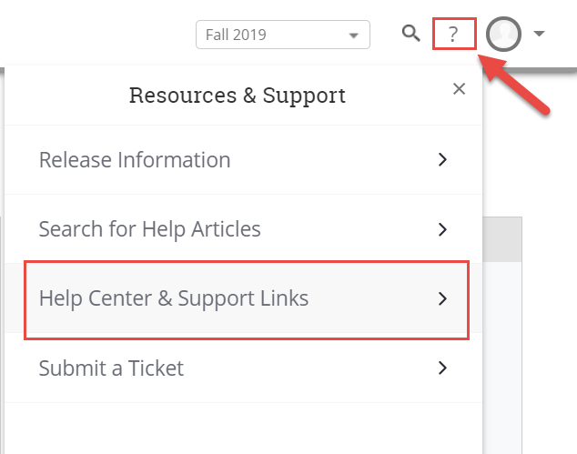
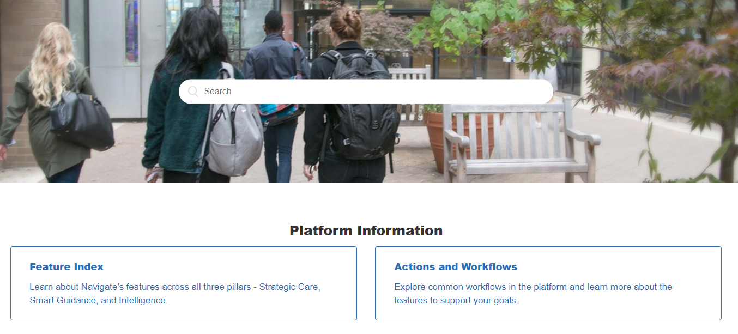
Need Help? Access EAB’s Help Center
Visit the Navigate Help Center for articles and how-to instructions on all Navigate Features and Workflows.
Accessing the Help Center -
Step 1: Log in to Navigate
Step 2: Click on the question mark icon in the top right hand corner.
Step 3: Click Help Center & Support Links from the drop down menu
Step 4: Select Help Center to be taken to articles and step by step instructions for Navigate features and workflows
Additional Questions? Email xxx for support!

