Slide 1
Adopting the Pharmacists’ Patient Care Process (PPCP) To Optimize Patient Care Outcomes
Nicole Culhane, PharmD, FCCP, BCPS
Sherry Moore, RPh

Slide 2
Objectives
Identify the importance and key steps of the Pharmacists’ Patient Care Process.
Understand key practices of what pharmacists do using the Pharmacists’ Patient Care Process.
Evaluate a patient case utilizing the Pharmacists’ Patient Care Process.
Develop a pharmacy practice service utilizing the Pharmacists’ Patient Care Process.
Utilize the Pharmacists’ Patient Care Process when mentoring pharmacy students during clinical experiences.

Slide 3
Agenda
Why Now? Understanding the Importance of the Pharmacists’ Process of Care.
Understanding Key Steps of the Pharmacists’ Patient Care Process.
Understanding Key Practices of WHAT Pharmacists DO Using the PPCP.
Applying the PPCP to a Patient Case Study.

Slide 4
Why Now?
Understanding the
Importance of the
Pharmacists’ Process of Care

Slide 5




Have you flown ………..... Lately?
M

Slide 6
Understanding the
Pharmacists’ Process of Care¹
JCPP Vision:
  “Patients achieve optimal health and medication outcomes with pharmacists as essential and accountable providers, within patient-centered team-based health care.”

Slide 7
Understanding the Pharmacists’ Process of Care¹
Organizations and Stakeholders supporting the PPCP | AMCP, ACPE, AACP, ACA, ACCP, APhA, ASCP, ASHP, FMI, NASPA, NABP, NACDS, NCPA
The Need for the PPCP | Successful measurement of outcomes of pharmacist patient care services Consistent process of care must be used
Foundational Tenets of the PPCP | 5 step process Patient-centered approach in collaboration with other providers to optimize patient health and medication outcomes Dependent on first and foremost having an established relationship with the patient

Slide 8
Understanding the Pharmacists’ Process of Care¹
Development, Adoption, and Implementation of the PPCP | Workgroup of representative of national pharmacy organizations Hepler and Strand’s: “Parmaceutical Care Practice” JCPP leading a profession wide rollout of PPCP E.g. ACPE Standard 2016

Slide 9
Understanding Key
Steps and Practices of the Pharmacists’ Patient Care Process (PPCP) and what Pharmacists should DO

Slide 10
Pharmacist’s Patient Care Process
Pharmacists use a ______________________________ approach in collaboration with other providers on the health care team to optimize patient _________________ and___________________________.
Patient centered
health
medication outcomes

Slide 11
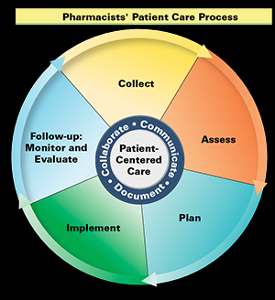
Pharmacist’s Patient Care Process
Using the principles of evidence-based practice, pharmacists:
C________
A________
P________
I_________
F________
ollect
ssess
lan
mplement
ollow-up

Slide 12
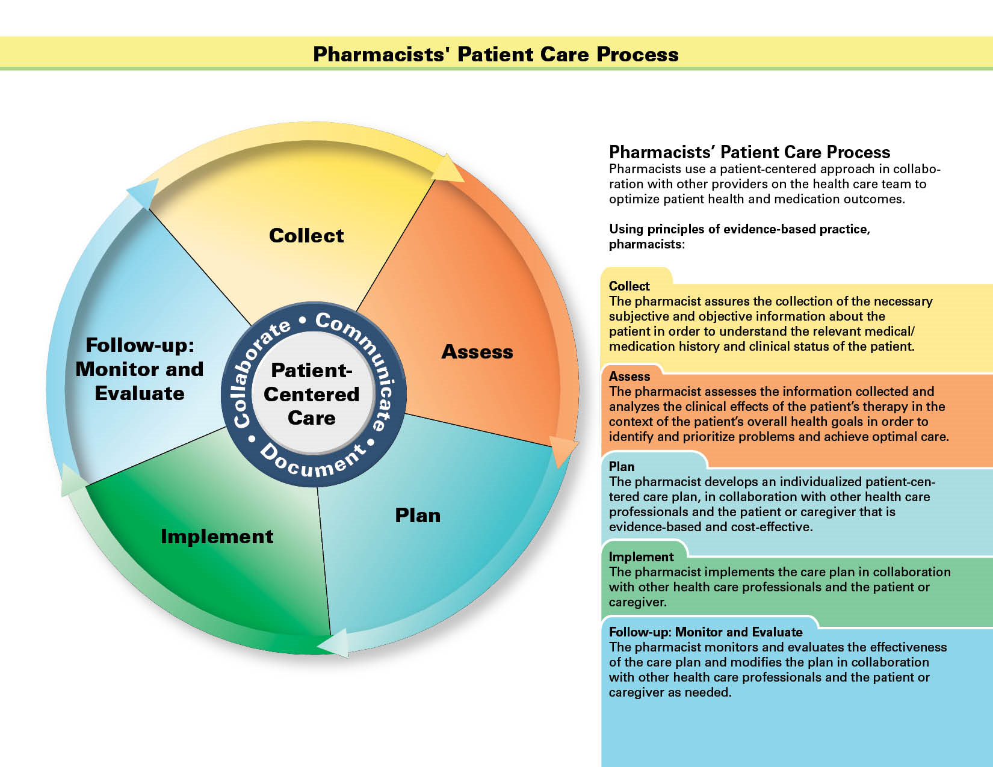

Slide 13
The pharmacist assures the collection of necessary subjective and objective information about the patient, this process includes collection of which of the following:
Prescription medications
Medical history
Health and wellness information
Nonprescription medications
Tests
Physical assessment findings
Medication appropriateness
Patient lifestyle habits
Socioeconomic factors
Herbal products
Preferences and beliefs
Medication list
Dietary supplements
Health and functional goals

Slide 15
The pharmacist assesses the information collected and analyzes the clinical effects, this process includes assessing for which of the following:
Medication adherence
Cultural factors
Medication related care plan
Medication effectiveness
Health data
Risk factors
Preventative care/other health care services
Access to medication
Health literacy
Immunization status
Medication appropriateness
Access to aspects of care
Medication safety
Health and functional status

Slide 17
The pharmacist develops an individualized patient-centered care plan; this process includes establishing a care plan that consists of addressing which of the following:
Medication related problem
Sets goals of therapy
Patient education
Optimization of medication therapy
Patient empowerment
Care continuity: follow-up and transitions of care
Patient self-management
Vaccine administration

Slide 19
The pharmacist implements the care plan in collaboration with other health care professionals and the patient or caregiver; this process includes the pharmacist implementing which of the following:
Initiates medication
Providing education/self-management training
Modifies medication
Addresses medication/health-related problem
Engages in preventative care strategies
Achievement of goals of therapy
Administers medication
Discontinues medication
Schedules follow-up care

Slide 20
PPCP: Implement
S = Situation:
  Identify the patient and the reason for initiating the communications
B = Background:
  What is the relevant history or data needed to evaluate the situation
A = Assessment:
  What assessments have been made, and what problem do you think is occurring
R = Recommendation:
  Define the actions needed and recommend specific solution

Slide 22
The pharmacist monitors and evaluates the effectiveness of the care plan and modifies the plan; this process includes continuous monitoring and evaluation of which of the following:
Outcomes of care
Medication appropriateness
Medication effectiveness
Medication safety
Medical history
Patient adherence
Clinical endpoint

Slide 23
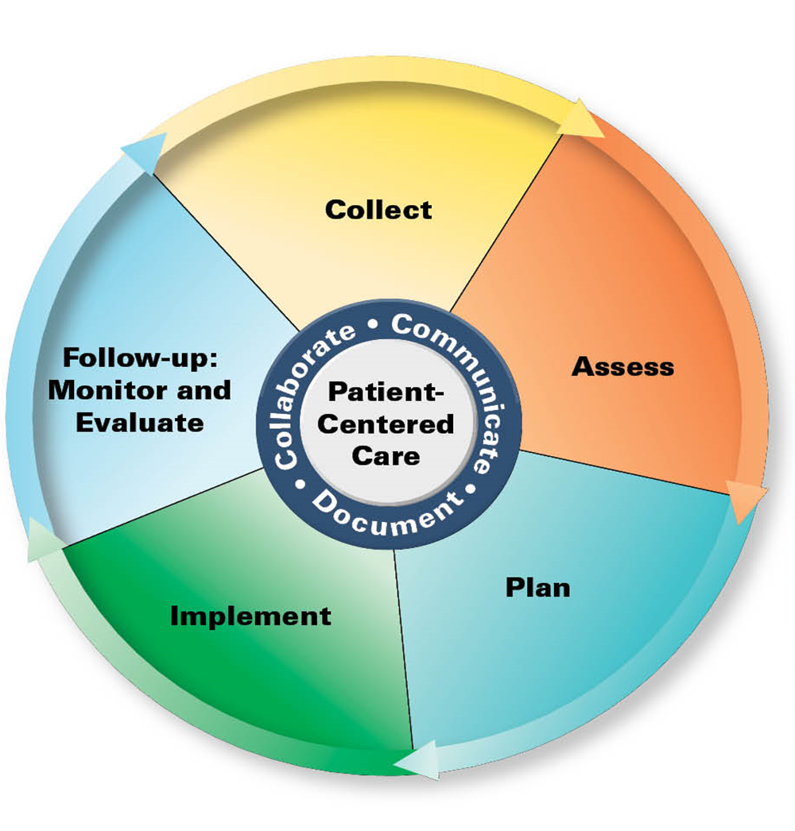
Applying the PPCP: “Implement” and “Follow-Up”
A good plan will help in ensuring that the right steps are taken in implementing your recommendations and reassessing at follow-up.
Can use the same steps as taken to assess your current process of care for alignment to the PPCP.
M

Slide 24
Conclusion¹
Providing consistent, effective, and efficient patient-centered care is critical
Use of the PPCP can assist ensuring existing and/or new patient care services meet regulatory and financial requirements in the current evolving health care system
Use of the Pharmacists’ Patient Care Process will advance the contribution by pharmacy practice to meeting the goal of high-quality, cost effective, and accessible health care for all patients
M

Slide 25
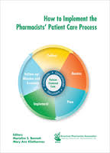
Reference
1. Bennet M, Kliethermes M, eds. How to implement the pharmacists’ patient care process: a systematic approach. Washington, DC: APhA; 2015: pages 1-66.

